Slide 1
Unlocking Value
Data-Driven Discount Decisions

Slide 2
In today's dynamic market landscape, companies are:
constantly challenged to strike a delicate balance between maximizing profits and staying competitive.
Pricing strategies play a pivotal role in this equilibrium, influencing consumer behavior, market positioning, and ultimately, the bottom line. As data scientists, our role is to harness the power of data to inform strategic decisions that drive business growth and success.

Slide 3
Companies are challenged :
Maximizing revenue and staying competitive.
Pricing strategies
Consumer behavior
Maintaining revenue
Discount strategies

Slide 4
90% of products are sold With discount
95% from the total revenue
20% Average discount

Slide 5
Discounted sales
Total number of products sold: 53646
Number of products sold with discount: 51085
Number of products sold without discount: 2561
Percentage of products sold with discount: 95.22
Percentage of products sold without discount: 4.77
Average discounts: 20%

Slide 6
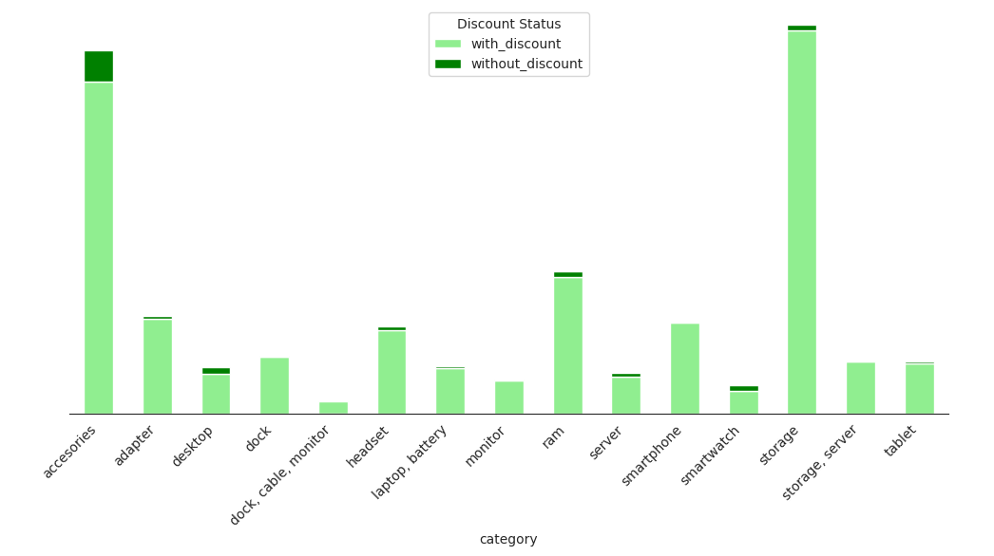
Significantly Higher Sales Volume with Discounts

Slide 7
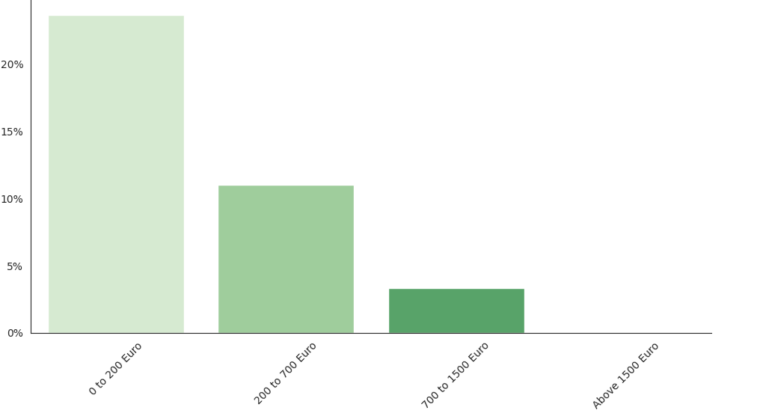
Discounts Amplified for Lower-Priced Products

Slide 8
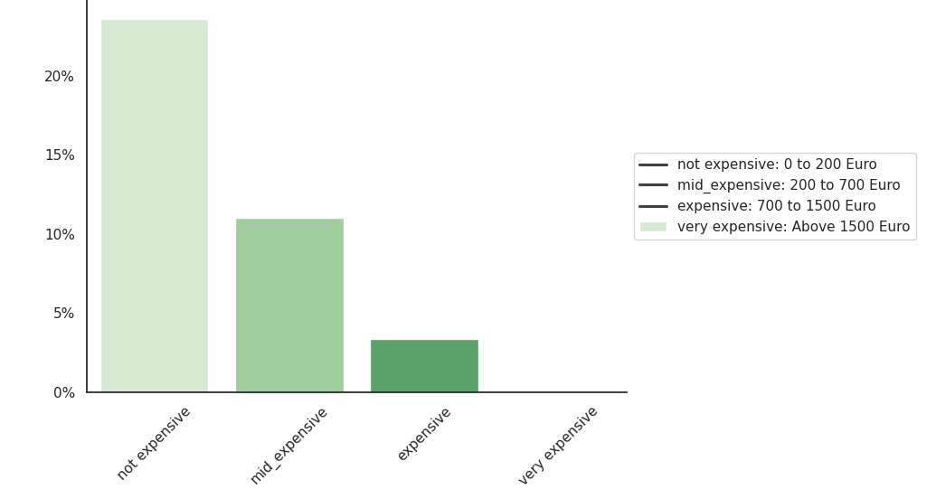

Slide 9
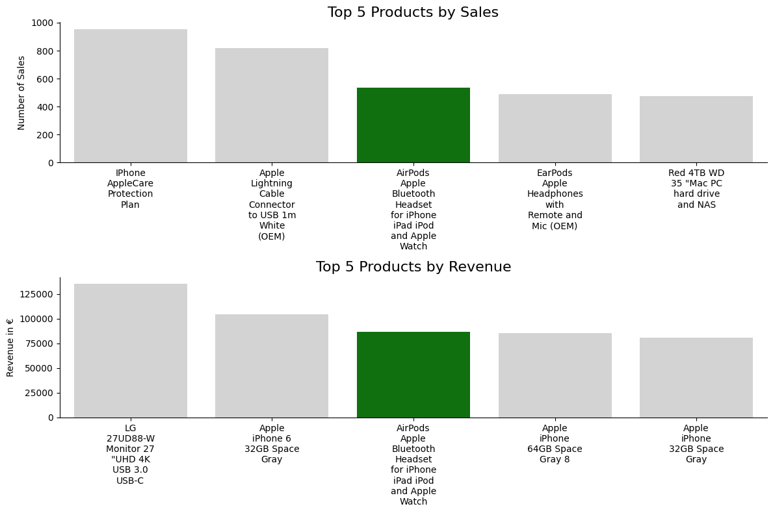
Apple AirPods - A Prime Example of ENIAC's Discount Strategy

Slide 10
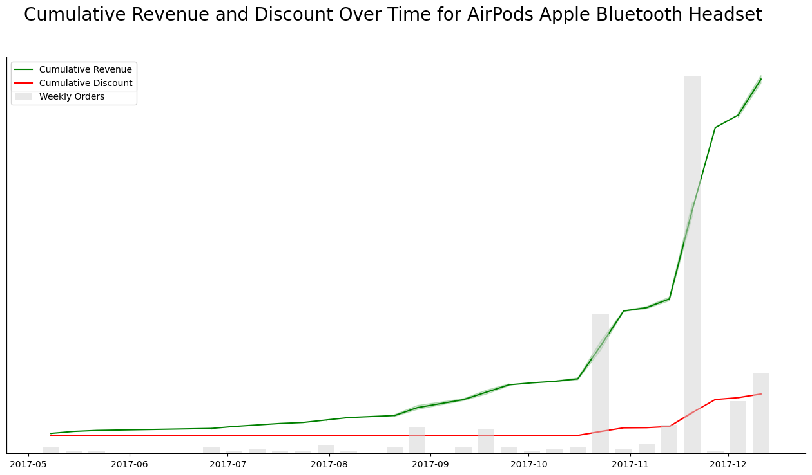
Apple AirPods - Moderate Year-End Discounts Have A Strong Leverage Effect
→ 83% more orders
no discount
9-14% discount

Slide 11
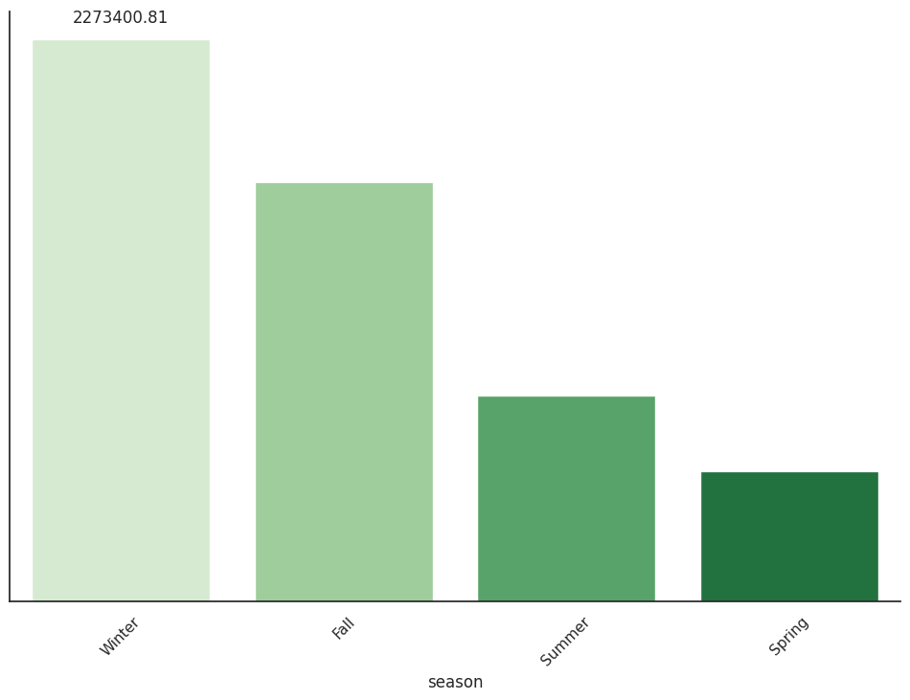
Q₄ Revenue Peak
Revenue in Q4 = 2.3 M Euro
Q₄
Q₃
Q₂
Q₁

Slide 12
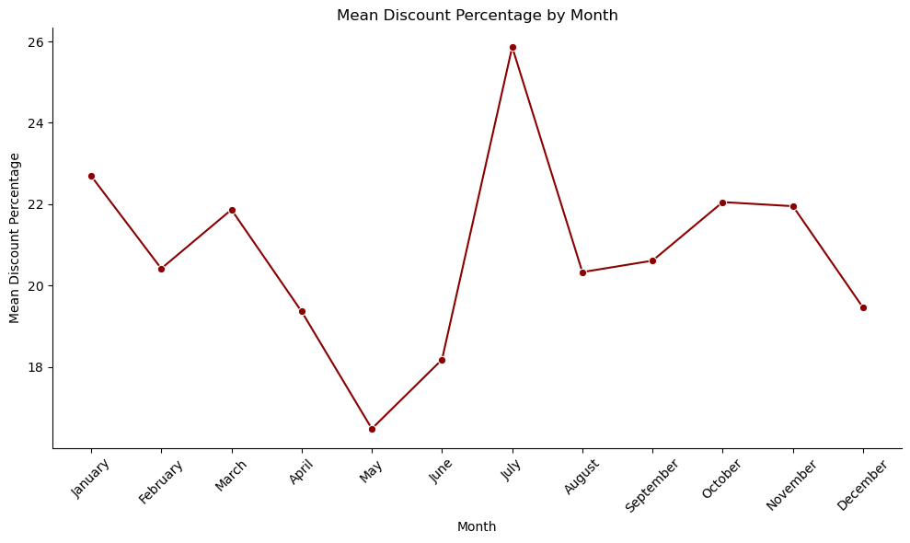
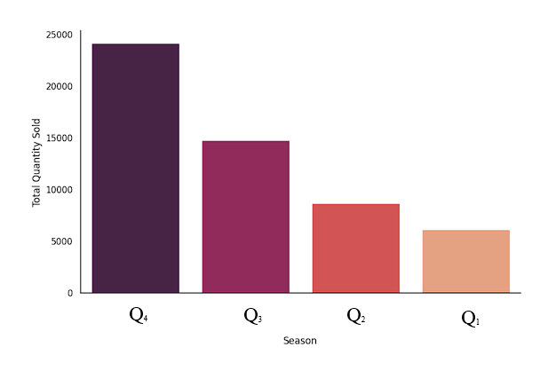
Q₄ Product sold Peak
July Discount% Peak

Slide 13
Recommendation
Apply discount in the Q4 of the year
Optimizing the impact on sale
Maintaining the high revenue

Slide 14

Thank You!

Slide 15
Appendix

Slide 16
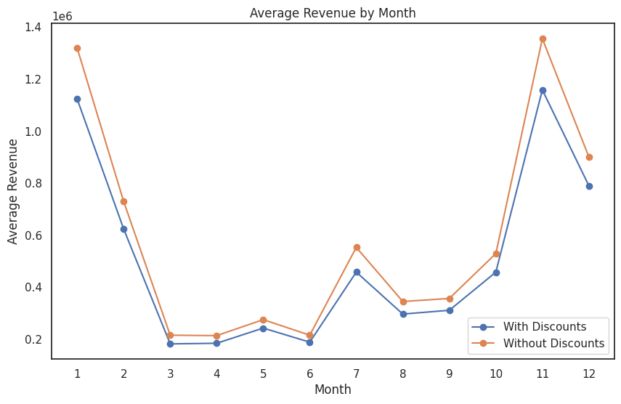

Slide 17
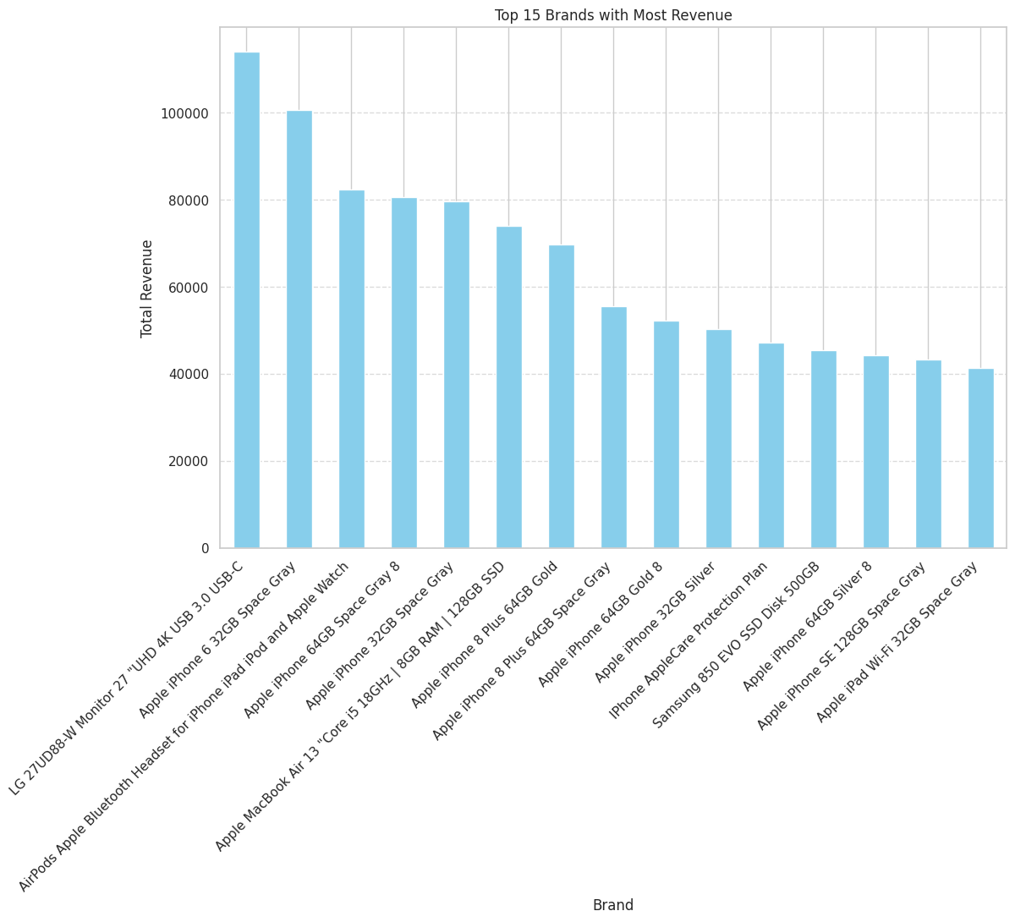

Slide 18
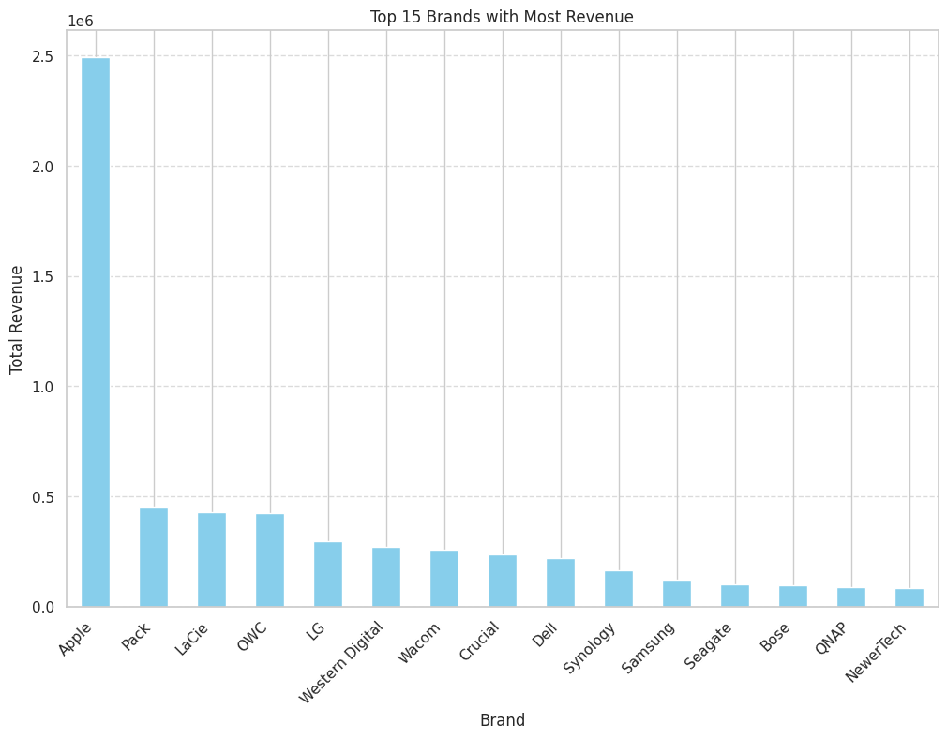

Slide 19
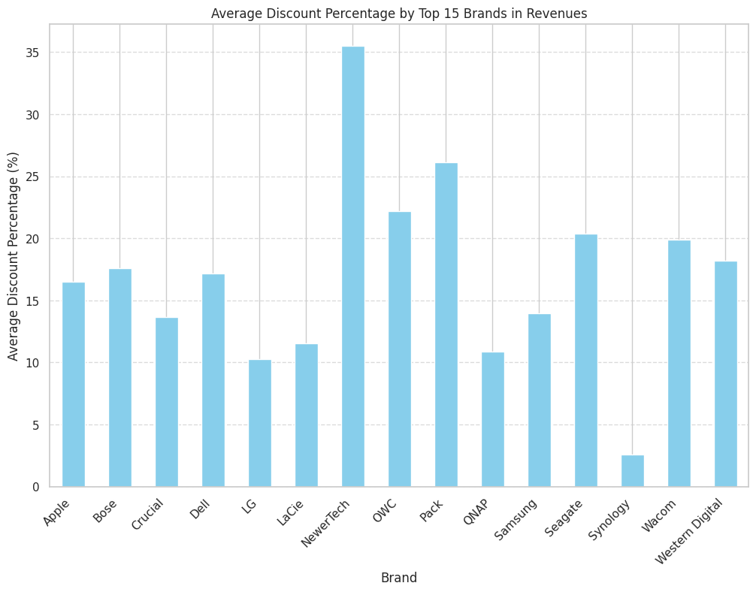

Slide 20
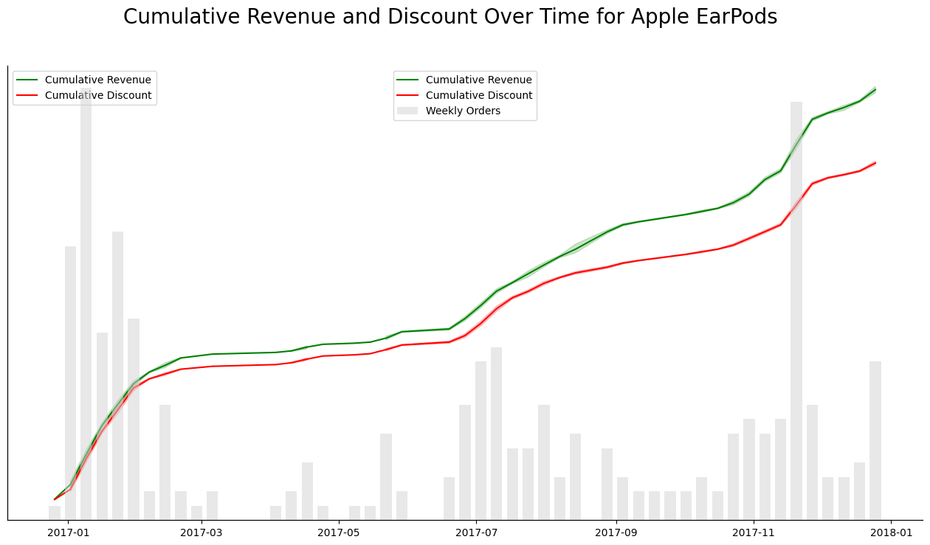

Slide 21
